Slide 1
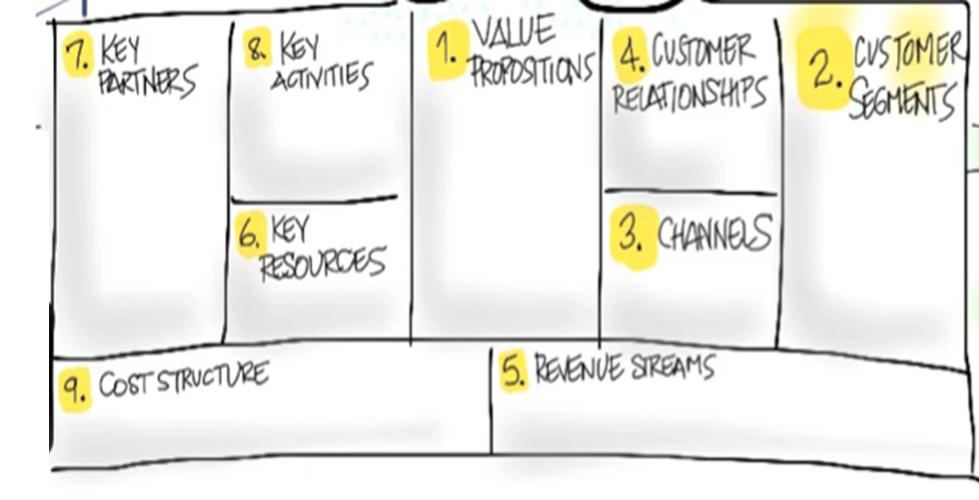
John Luke Denny, Brian Tsai, Nick Levergne, Corin Canepa
Creating a detailed plan for what is to be developed. From there two teams are formed to split the tasks between UI and Background. Meanwhile, the code is constantly being tested and maintained.
Currently there are none.
With the rise of COVID-19, people have grown increasingly concerned with tracking diseases. Starting with COVID in the US, we plan to create an app that gives an easy way to view the statistics of diseases.
We are providing a unified source of disease data.
Currently, there are very few disease tracking sites. Of which, there are very few that have more than a few disease readily available to view the stats of.
Government and public API’s
Desktop app, iOS app, and google play app.
Free app with adds. If businesses want to develop with it, there will be a fee.
The only cost to the development is time.

